Slide 1
HTML
Lab 18: Basic HTML (HTML Table)

Slide 2


Welcome to HTML Class

Slide 3

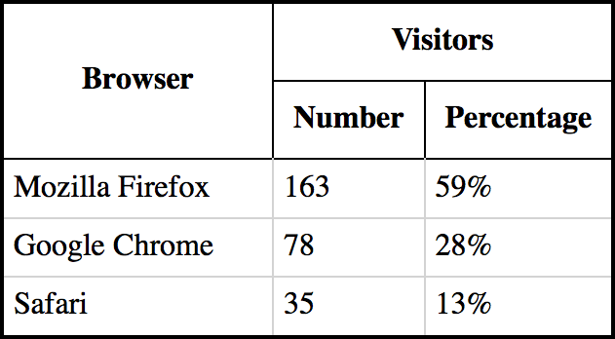
HTML Table
The HTML tables allow web authors to arrange data like text, images, links, other tables, etc. into rows and columns of cells.

Slide 4
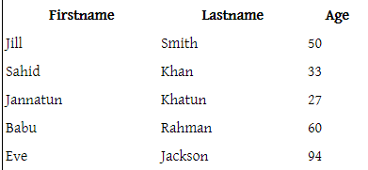
HTML Table
The HTML tables are created using the <table> tag in which the <tr> tag is used to create table rows and <td> tag is used to create data cells
<table style="width:60%">
<tr>
<th>Firstname</th>
<th>Lastname</th>
<th>Age</th>
</tr>
<tr>
<td>Jill</td>
<td>Smith</td>
<td>50</td>
</tr>
…………….. ……..
</table>

Slide 5
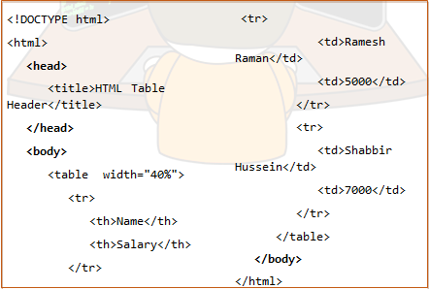
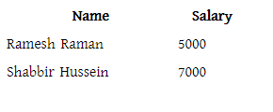
HTML Table Heading

Slide 6
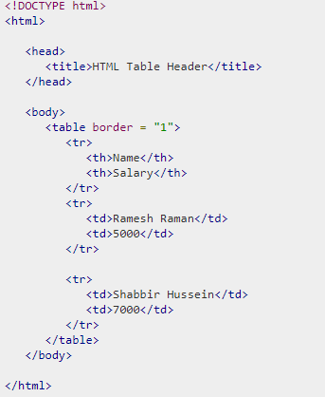
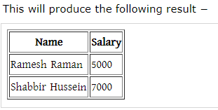
HTML Table Border

Slide 7

Today’s learning:
HTML Table
Thank You!

